Slide 1

High Performance
Talent Identification, development, support, promotion, Retention

Slide 2
Objectives
The key goal of Clonmel Athletic Club’s high performance programme is to adopt a best in class approach to identify, develop, support, promote and retain talented athletes capable of winning at senior national and international level.
Work with athlete's existing support network (coaches/parents/sponsors) to ensure an holistic approach to complement their existing training and support services.
Ensure the athlete’s needs are centre stage so that their development and success promotes both them as an individual while enhancing the standing of the club.

Slide 3
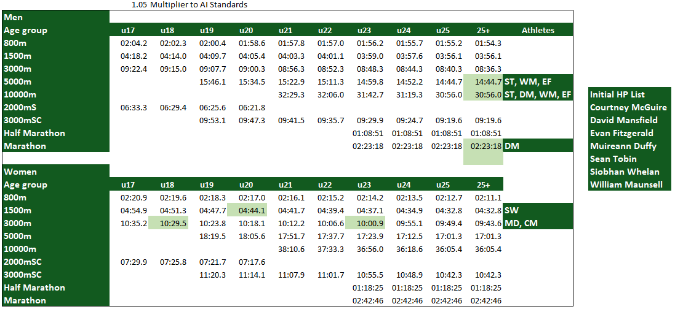
Performance criteria

Slide 4
Proposed Supports
Financial
Non Financial
Physiotherapy Subsidy
Sports Psychologist Consultation Subsidy
S&C Consultation Subsidy
Sports Nutrition Consultation
Lactate/VO2 Max Testing Subsidy
Club training gear subsidy
HP Athlete Networking & Collaboration
Dedicated Liaison Officer/Co-Ordinator
Promotion of Coach Networking
Group Runs
Team Goal Setting re National Competitions
Athlete led workshops/squad days

Slide 5
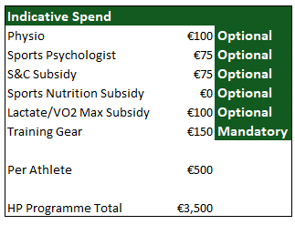
Proposed Support costs

Slide 6
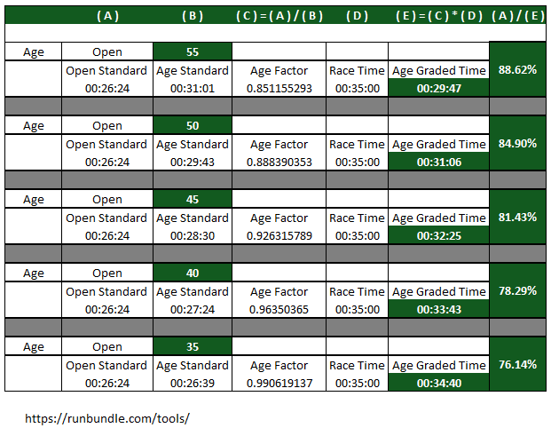
WAVA – Promoting Masters Performance

Slide 7
Discussion

